Slide 1
Talking through trace gas paper story – too many things for one manuscript?
Hobbie lab mtg, 25-Mar-2015

Slide 2
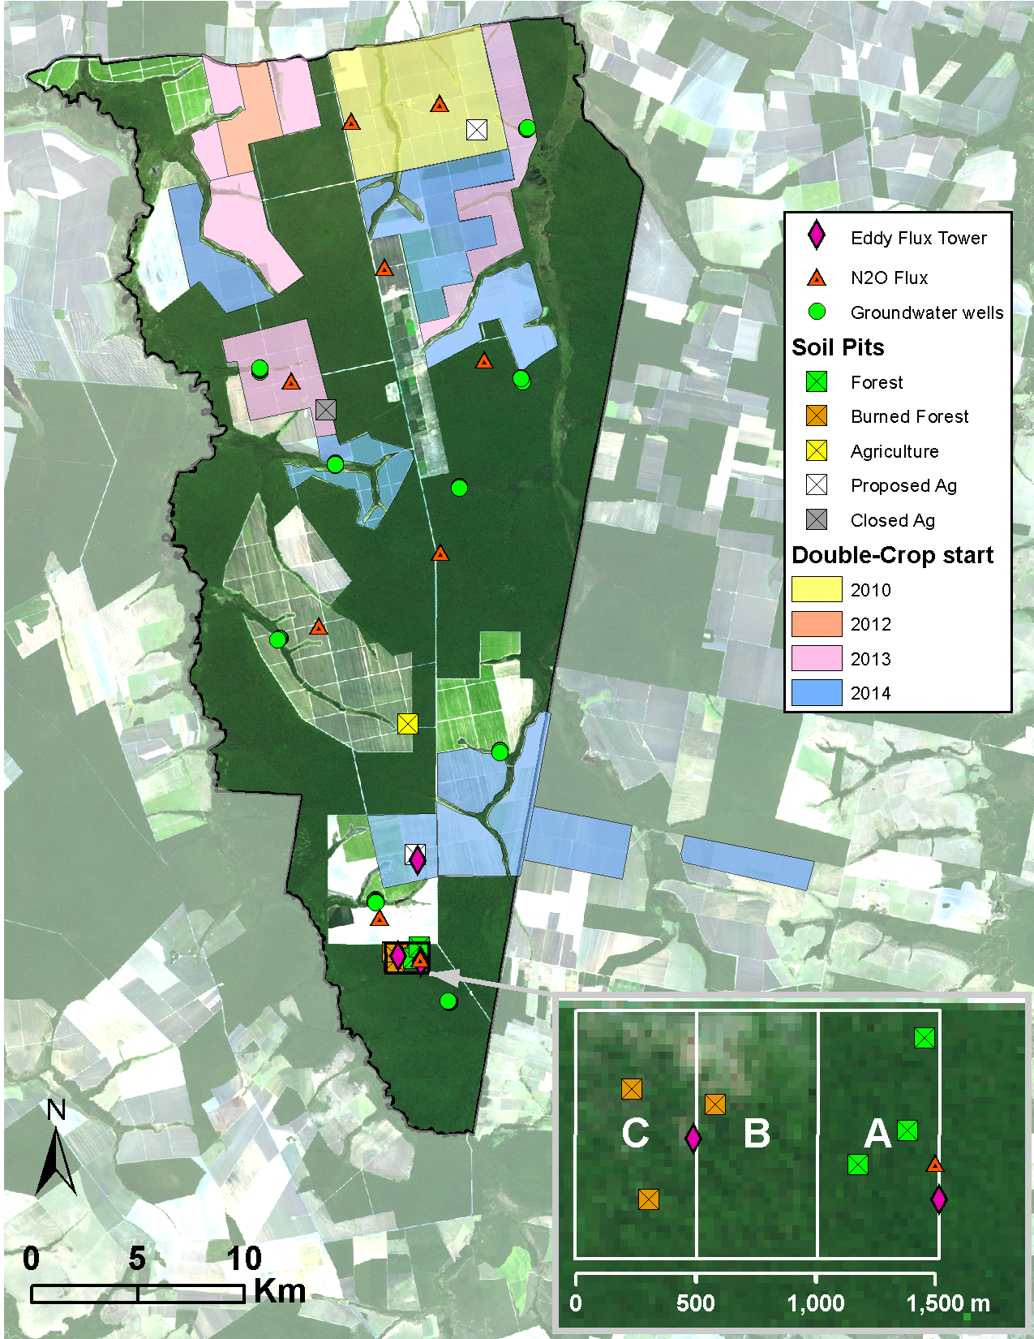
Three land uses (forest, soy, soy + corn), three sites per land use, sampling over 1.25 years Collected N₂O, CO₂, CH₄, soil vars
Notes:
Q: what soil vars to represent in a table?

Slide 3
Framing right now is:
Mechanized agriculture is rapidly becoming the new norm in this tropical system (and likely others in the future)
That’s changing soil inputs in X, Y, Z ways
How these novel changes affect GHGs is poorly understood for tropical, highly-weathered soils
Here, we ask how cropland intensification is changing GHG emissions at the plot and landscape level along a “new frontier” of agricultural intensification
Notes:
Make sure to make it very clear what’s different about this system vs. temperate/other tropical places → how we might expect that to change trace gas emissions → what we’re not sure about those relationships
Mechanisms will work differently because of A, B, C
What we don’t know much about how those dynamics might play out
THEN give the one-two punch that this is especially relevant because of the rapid land use changes

Slide 4
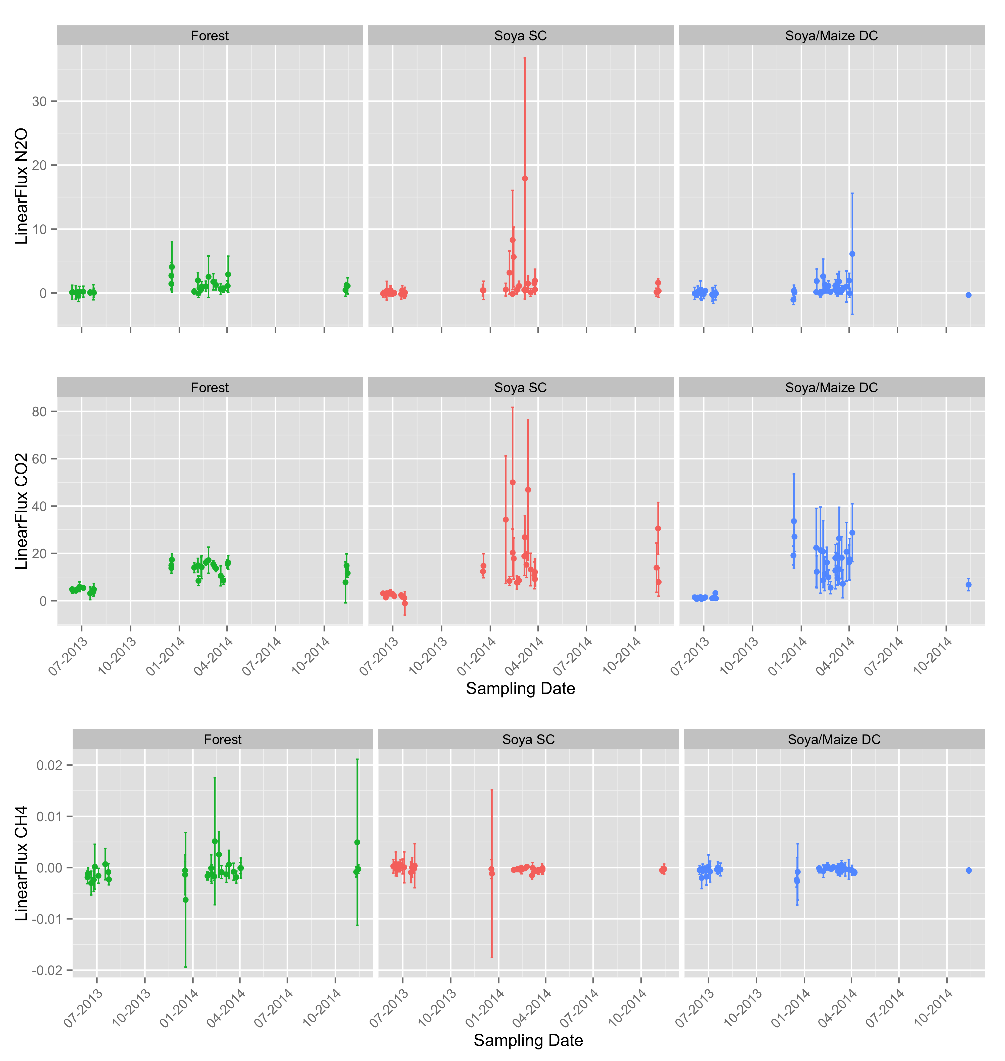
A. Trace gas emissions (plot level)

Slide 5
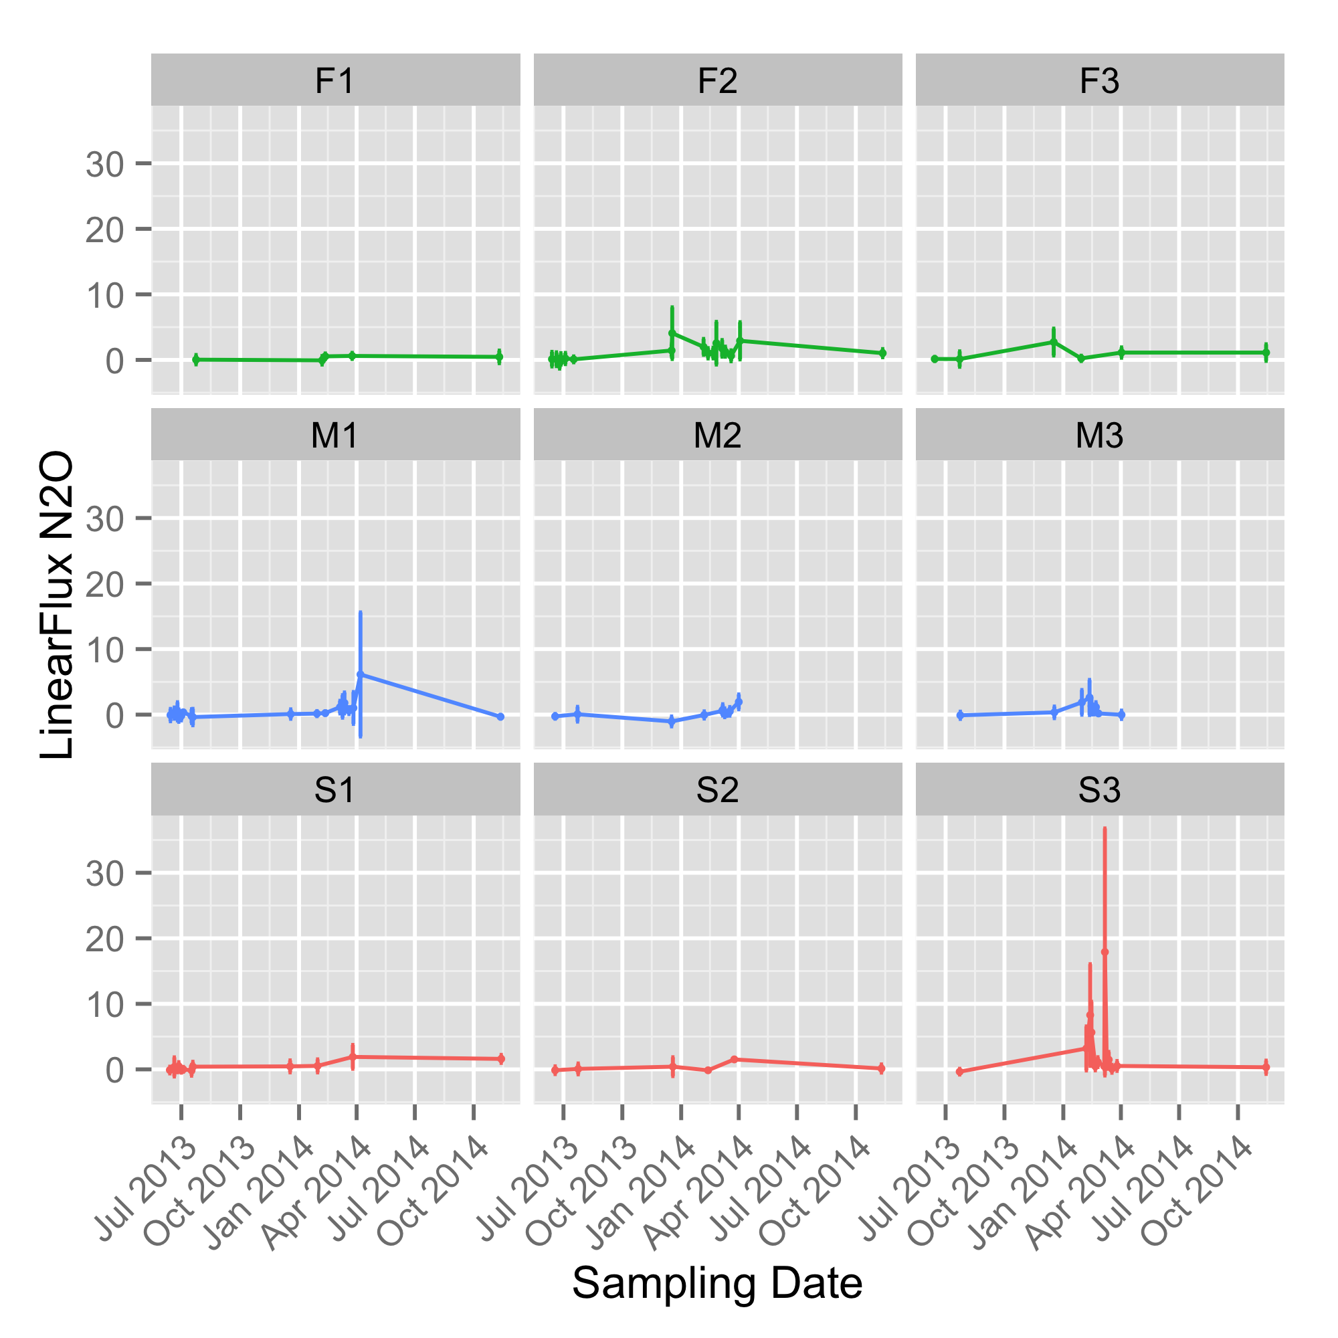
Notes:
Make sure to include context of how “big” fluxes are in comparison to other types of fert flux increases

Slide 6
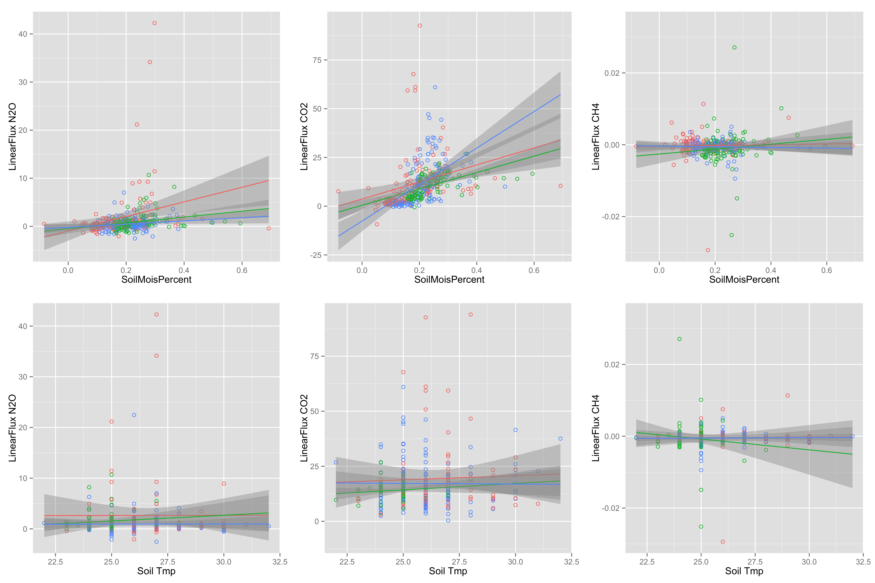
B. Soil variables (N pools/fluxes, C pools, WFPS, temp)
Notes:
Look up what type of test I should use to figure out regression shape
Include an interactive nitrate/moisture term in the model
NO:N2O ratio – include in discussion
Combine this data with the (A) results since they inform the emissions profiles

Slide 7
C. Trace gas emissions, seasonal + management extrapolation
This part it’s hard for me to work on without all of the soil data in… unclear which variables will be the best predictors
TBD!

Slide 8
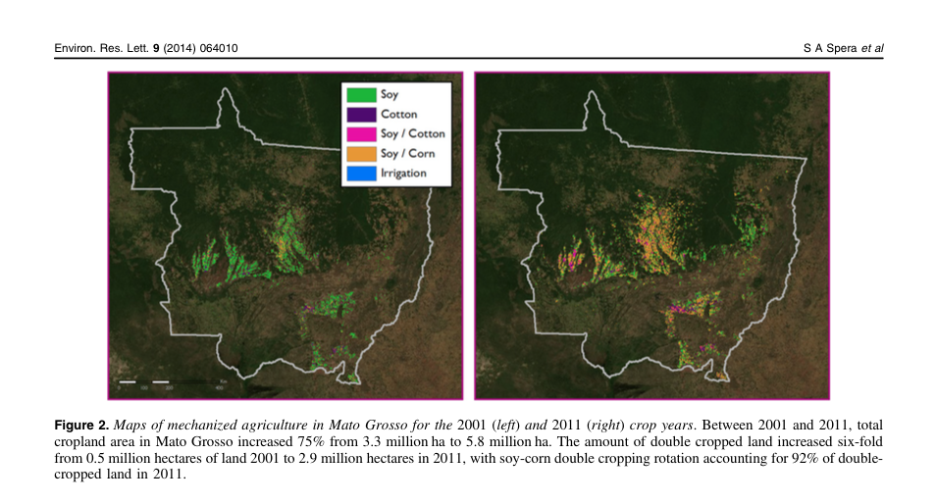
D. Apply to intensification in region, 2001-2011
Notes:
Do some critical thinking about soil type at Tanguro and where at the larger scale it’s similar/different, and what that means for how these patterns can be interpreted

